Slide 1

SOLO PROJECT
Northwind Traders Dataset
BY
ALFIAN
Notes:
Selamat pagi rekan penguji semua, hari ini saya [name] akan membawakan final project tim alpha tentang Brazillian E-commerce Sentiment Analysis

Slide 2
DATA UNDERSTANDING
Notes:
Sekarang kita masuk ke data.

Slide 3
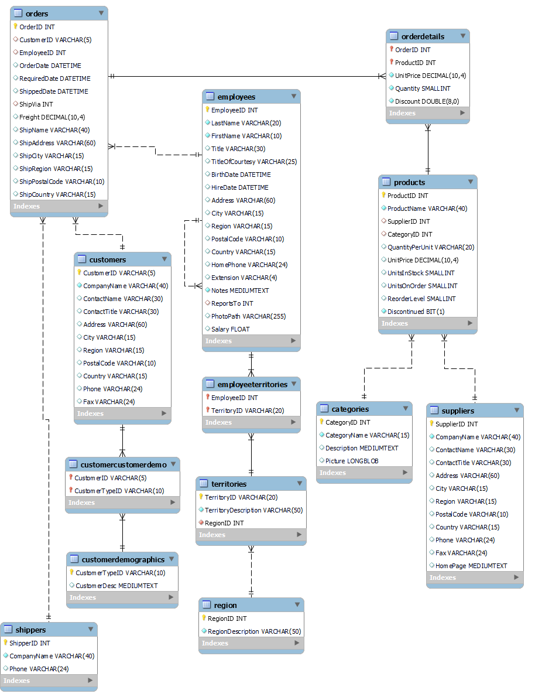
ENTITY RELATIONSHIP DIAGRAM
NORTHWIND TRADERS
Sources : https://www.kaggle.com/datasets/olistbr/brazilian-ecommerce
Notes:
Data Olist terdiri 8 dataset seputar transaksi e-commerce yang hubungannya bisa dilihat di gambar ini.
Dataset yang inti adalah orders_dataset dan order_items_dataset.

Slide 4
DATA UNDERSTANDING
TABLE 1 – Orders, Order detail, Products, Categories, Shippers
df_orders
df_order_details
df_products
df_categories
OrderID
Costumer_id
EmployeeID
OrderDate
RequiredDate
ShippedDate
ShipVia
Freight
ShipName
ShipAddress
ShipCity
ShipRegion
ShipPostalCode
ShipCountry
OrderID
ProductID
UnitPrice
Quantity
Discount
ProductID
ProductName
SupplierID
CategoryID
QuantityPerUnit
UnitPrice
UnitsInStock
UnitsOnOrder
ReorderLevel
Discontinued
CategoryID
CategoryName
Description
Picture
We already know that OrderID is the primary key. Only unique value. No duplicates on OrderID
We have 830 unique orders.
We have 89 unique customers in overall orders
Orders handled by 9 employees only
OrderID & ProductID in this table is not unique
This tables explain what items area in the order. Ex. OrderID 01 has ketchup, honey and milk.
We can see that we need to have 3 rows explaining that specific OrderID
In product table, we have unique ProductID.
Maybe to better know the item, we can use ProductName instead, but to join it to other table we need ProductID.
We understand that we have 2 UnitPrice (1 in df_products, 1 in df_order_details)
We can assume that df_products is the newest product catalogue. Where the catalogue is updated in certain time frame (price update).
Where as unit price in df_order_details is the product price when people order the item. Maybe from this, we can see price update from time to time
We understand that we have 77 unique product, which sometimes overwhelm us to do an analysis.
We can use CategoryName instead to get the whole picture better.
Notes:
Dan ini adalah jabaran dari 8 dataset tadi. Yang dibold di sini merupakan primary key karena berupa ID. Lalu, untuk keperluan EDA, hampir seluruh table kita gunakan untuk menggali insight. Tapi, untuk sentiment analysis, hanya table reviews saja yang digunakan.

